Slide 1
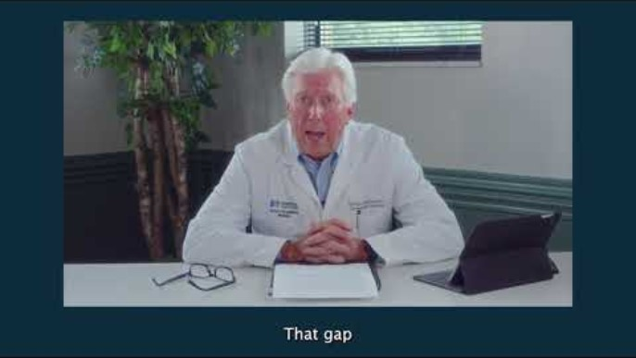
Physician Role in Stay at Work and Return to Work
Notes:
Medical Director, Norton Healthcare, Occupational Medicine
Fellow, American College of Emergency Physicians
Workers’ compensation expert for over 30 years
Extensive experience in SAW/RTW strategies.
Specialized medical evaluations used to determine if an employee can perform the essential functions of a job
Certified, American Board of Independent Medical Examiners
Certified, Medical Review Officer

Slide 2
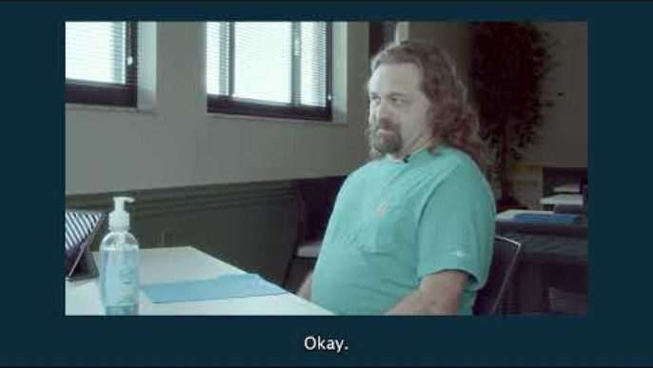
When Can My Patient Go Back To Work?
Notes:
Intro: https://youtu.be/p-xtAWU-0hA
Mock 1: https://youtu.be/X8e5JCgTVCg
Mock 2: https://youtu.be/-vORFgIqIaA

Slide 3
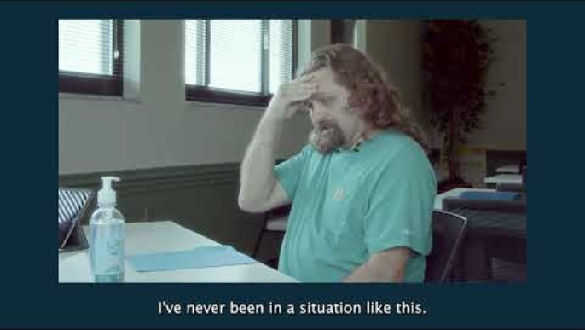
When Can My Patient Go Back To Work?

