Slide 1
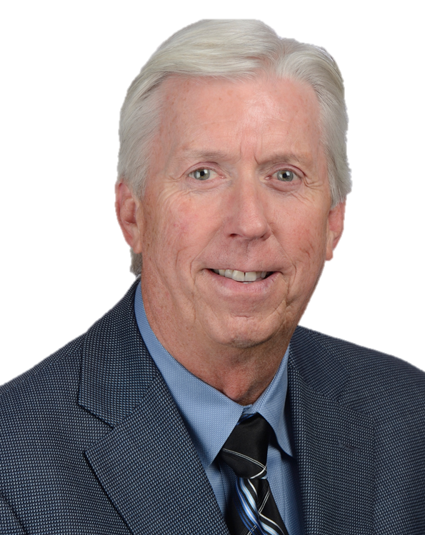
When can my Patient go Back to Work?
Dennis McClain, MD, FACEP, ABEM, MROCC
Medical Director, Norton Healthcare, Occupational Medicine
Please access the course by clicking the following link
à RETAIN Continuing Medical Education
Notes:
Medical Director, Norton Healthcare, Occupational Medicine
Fellow, American College of Emergency Physicians
Workers’ compensation expert for over 30 years
Extensive experience in SAW/RTW strategies.
Specialized medical evaluations used to determine if an employee can perform the essential functions of a job
Certified, American Board of Independent Medical Examiners
Certified, Medical Review Officer

Slide 2
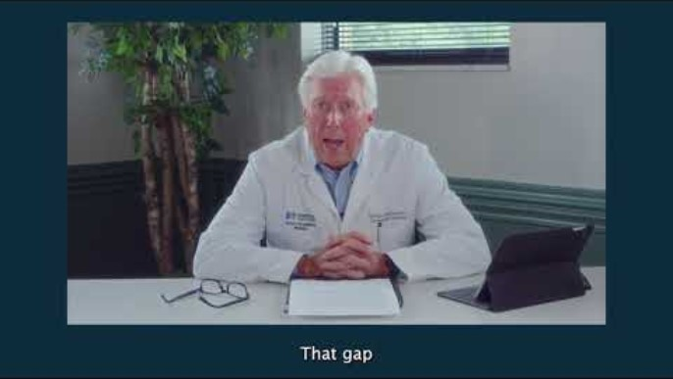
Notes:
Medical Director, Norton Healthcare, Occupational Medicine
Fellow, American College of Emergency Physicians
Workers’ compensation expert for over 30 years
Extensive experience in SAW/RTW strategies.
Specialized medical evaluations used to determine if an employee can perform the essential functions of a job
Certified, American Board of Independent Medical Examiners
Certified, Medical Review Officer

